Slide 1



Credit Card Project
View in Power BI
Last data refresh:
1/1/2024 9:35:50 AM UTC
Downloaded at:
1/1/2024 11:11:04 AM UTC

Slide 2
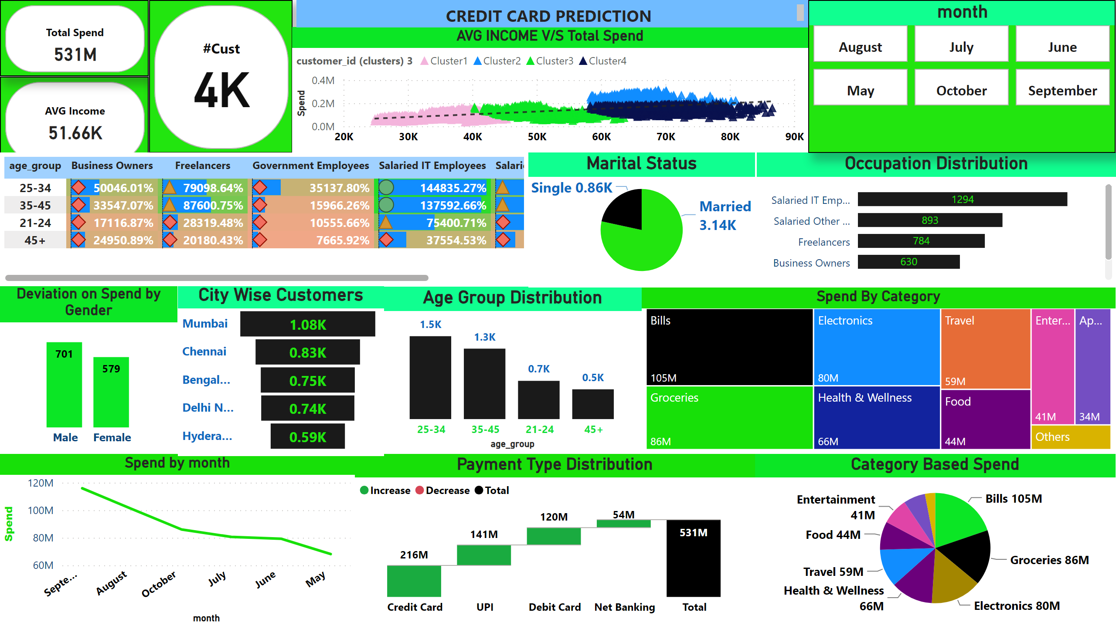
Spend Contribution
Notes:
lineChart
No alt text provided
Spend By Category
No alt text provided
Payment Type Distribution
No alt text provided
Category Based Spend
No alt text provided
Age Group Distribution
No alt text provided
City Wise Customers
No alt text provided
Occupation Distribution
No alt text provided
Marital Status
No alt text provided
AVG INCOME
No alt text provided
cardVisual
No alt text provided
cardVisual
No alt text provided
advancedSlicerVisual
No alt text provided
Deviation on Spend by Gender
No alt text provided
pivotTable
No alt text provided
AVG INCOME V/S Total Spend
No alt text provided
actionButton
No alt text provided
textbox
No alt text provided

